Slide 1
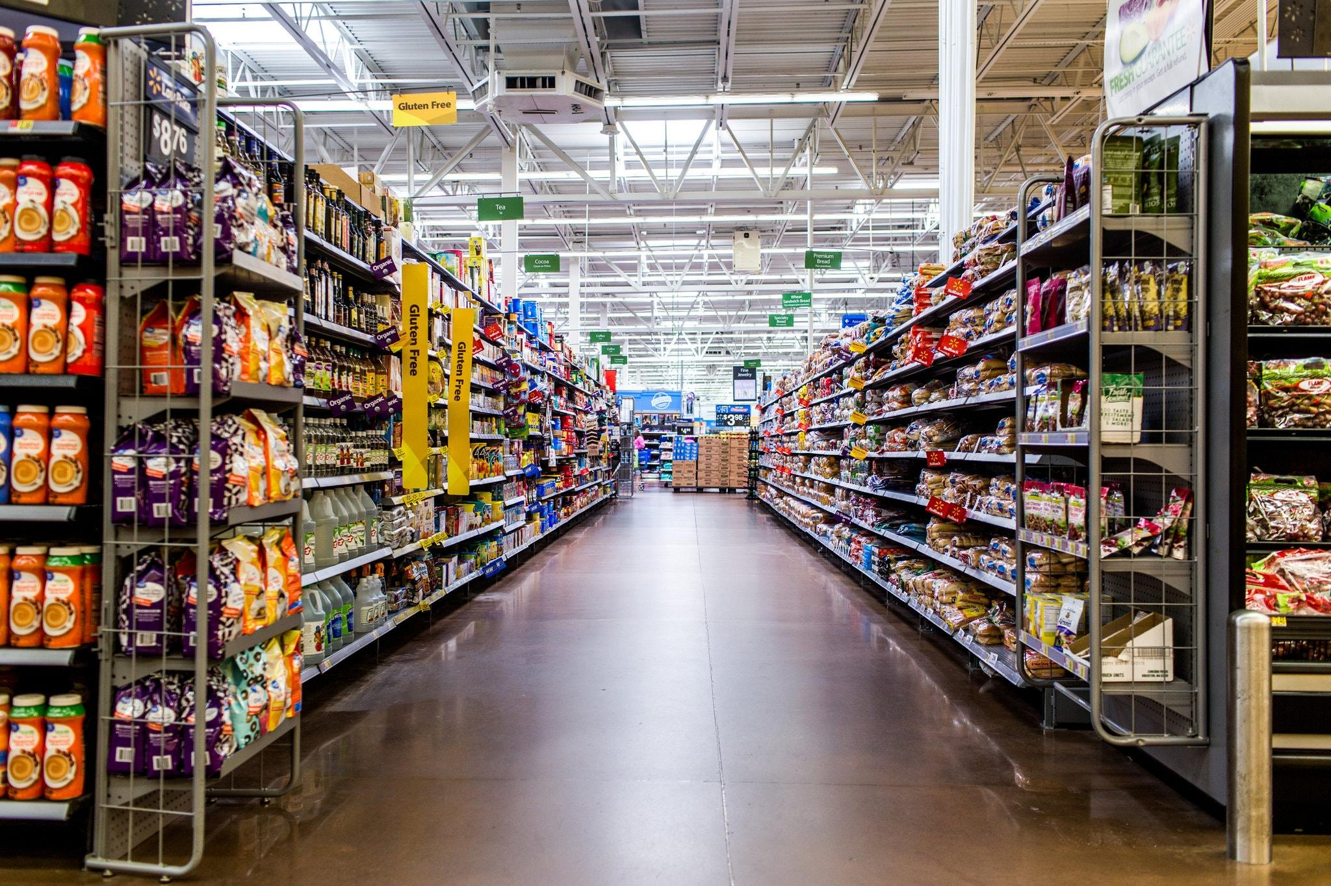

Walmart Inc.

Slide 2



Product Item Structure
Junhong Xu, Palakh Gupta, Sichun Zuo, Shivank Sood
Prof. Tejwansh Anand, Prof. Daniel Mitchell

Slide 3






Agenda
Business intent
Exploratory Data Analysis
Approach & Methodology
Operational Execution & Change Management
Conclusion
Next Steps

Slide 4





Walmart Inc.
Walmart Inc. helps people around the world save money and live better – anytime and anywhere – in retail stores and through eCommerce.
270M+
Weekly Customers
11,700+
Stores
65+
Online Banners

Slide 5
The Problem
All Walmart brands should have a consistent experience.
Need for better visibility across products
to identify opportunities to deepen relationship with customers
to help optimize supply chain, vendor relationships and other operational processes
Goals
To form a space in which the relative positions of items represent their semantic similarity.
To develop one consistent product categorisation using Walmart.com

Slide 6
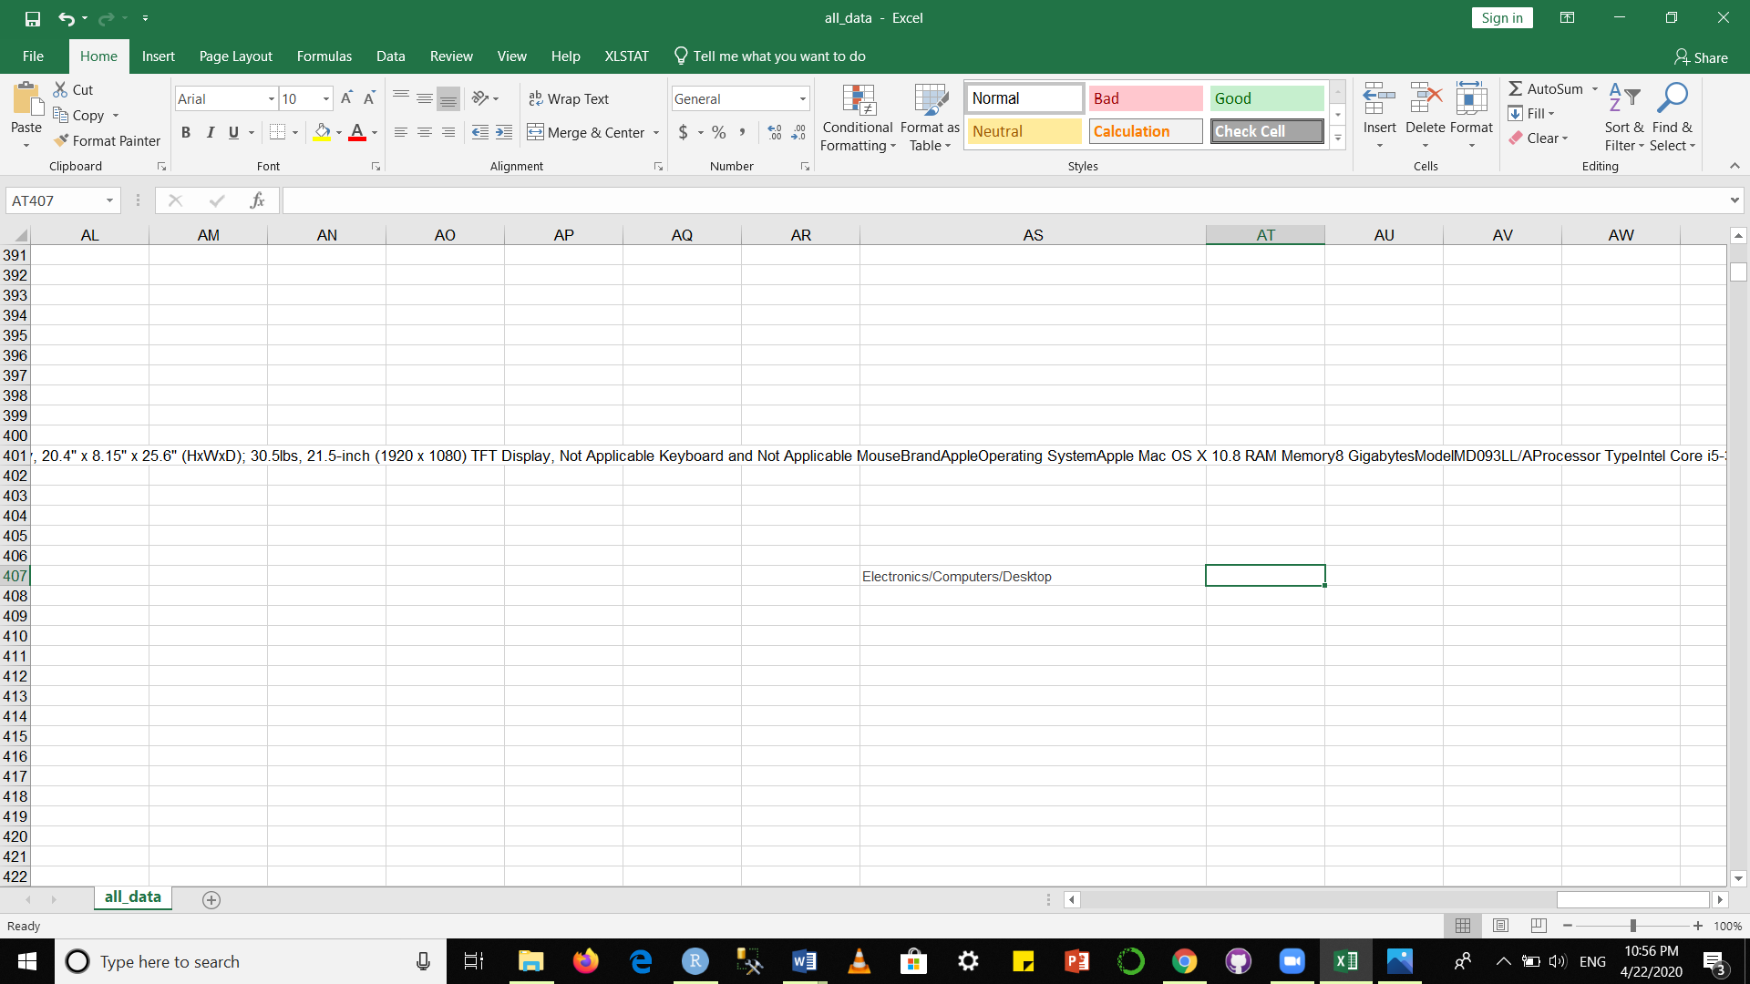
Business Value
Reduced manual labelling (categorization) hours for new products and products on subsidiary websites
Cleaning and Standardizing Categories for future product addition
The final product can be integrated to the internal analytics platform at Walmart - HUBBLE
Reduce computation time during Product Quote Analysis by the Audit Team
Product
Walmart Category
Standardized Category

Slide 7
Agenda
Business intent
Exploratory Data Analysis
Approach & Methodology
Operational Execution & Change Management
Conclusion
Next Steps

Slide 8
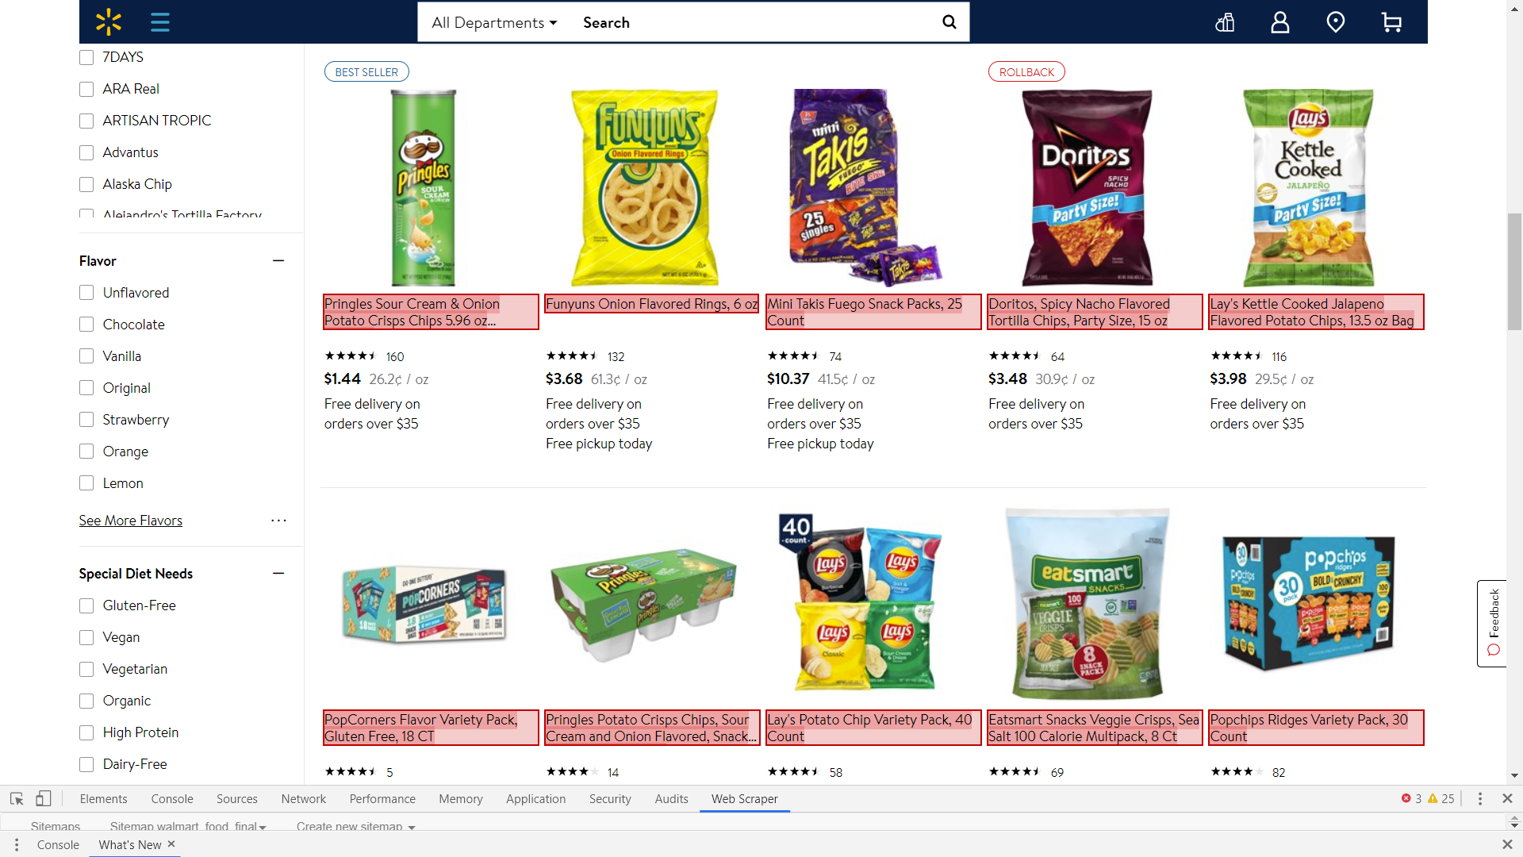
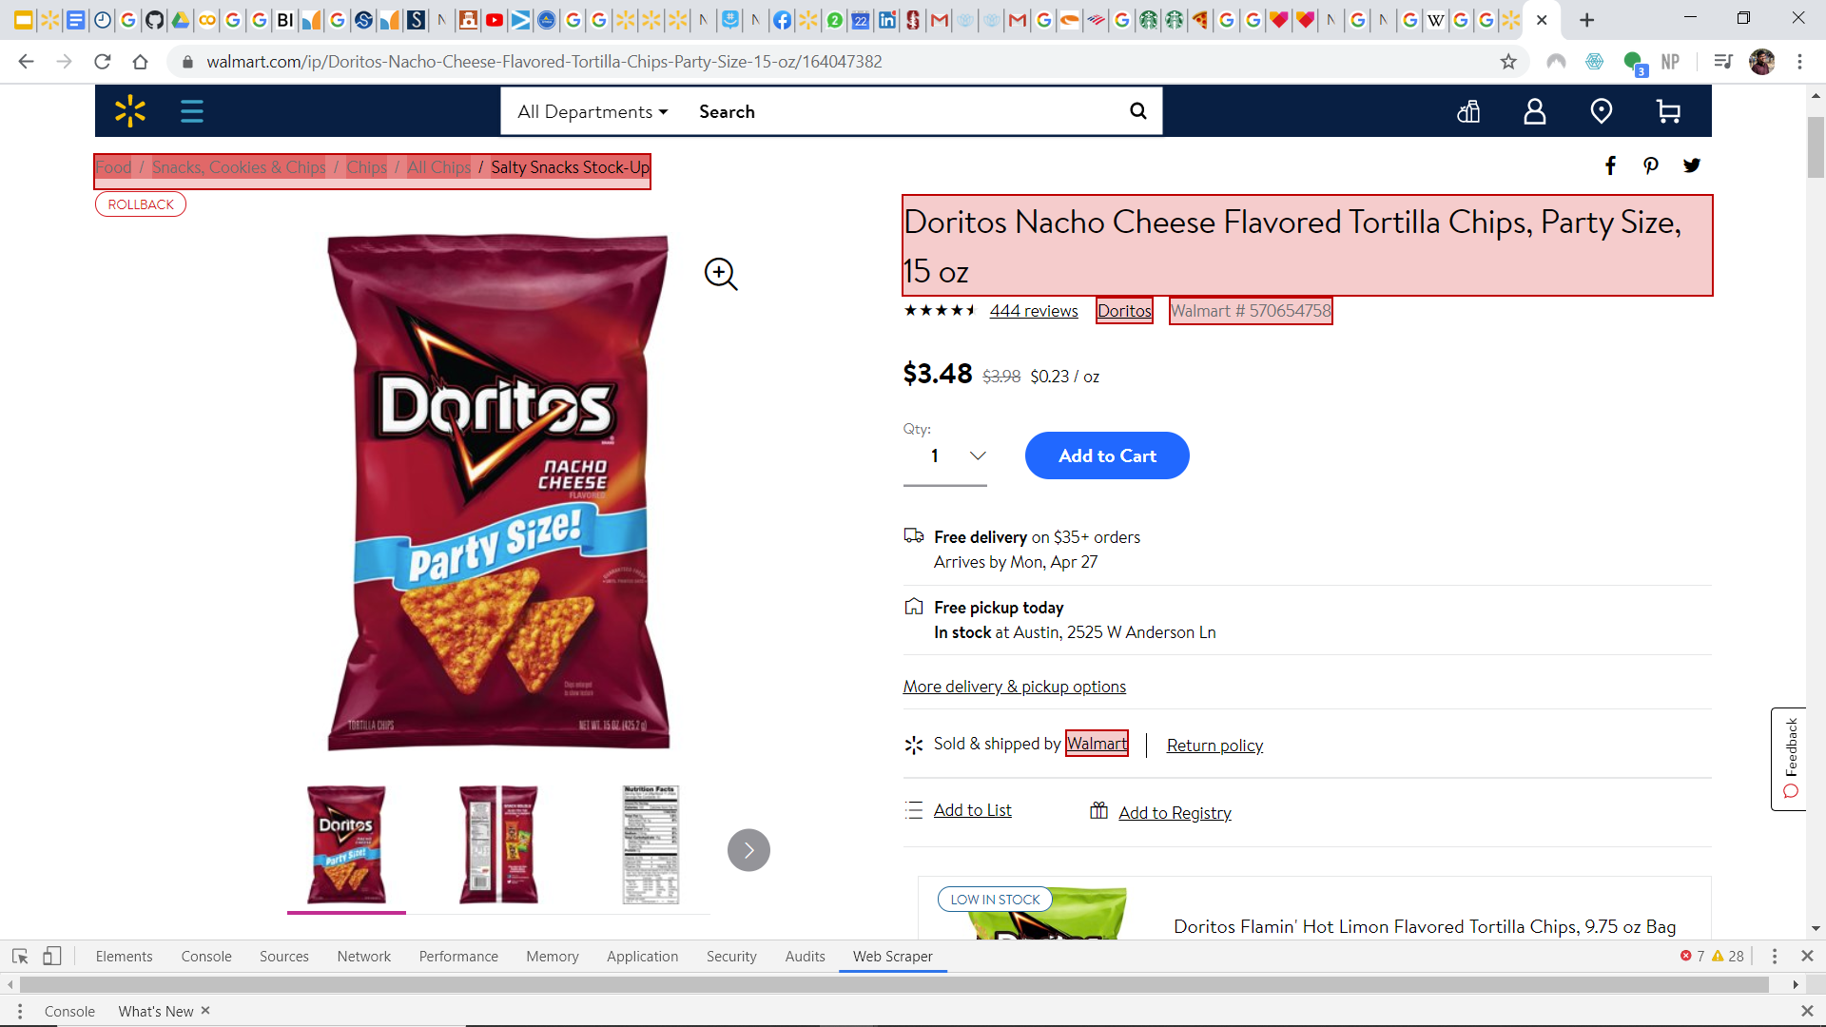
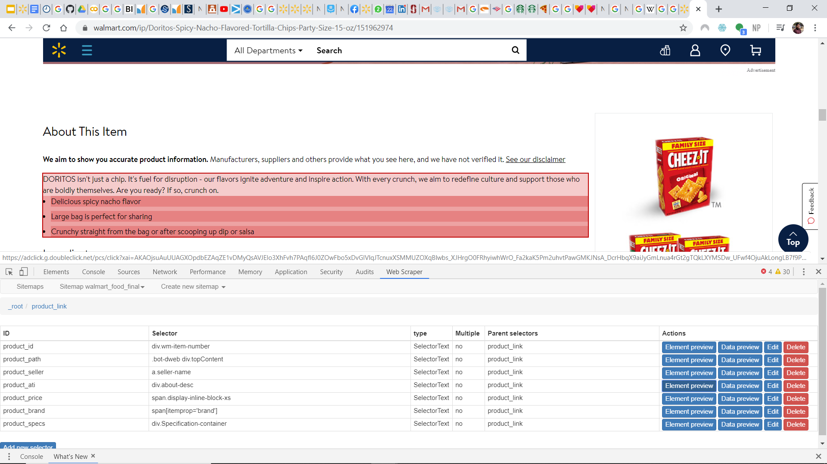
The Data
5
Base Categories
43M+
Products on Walmart.com
16,895
Products Scraped
3M+
Words Text Data Product Name Product Description
20
Sub Categories
112
Sub-Sub Categories

Slide 9
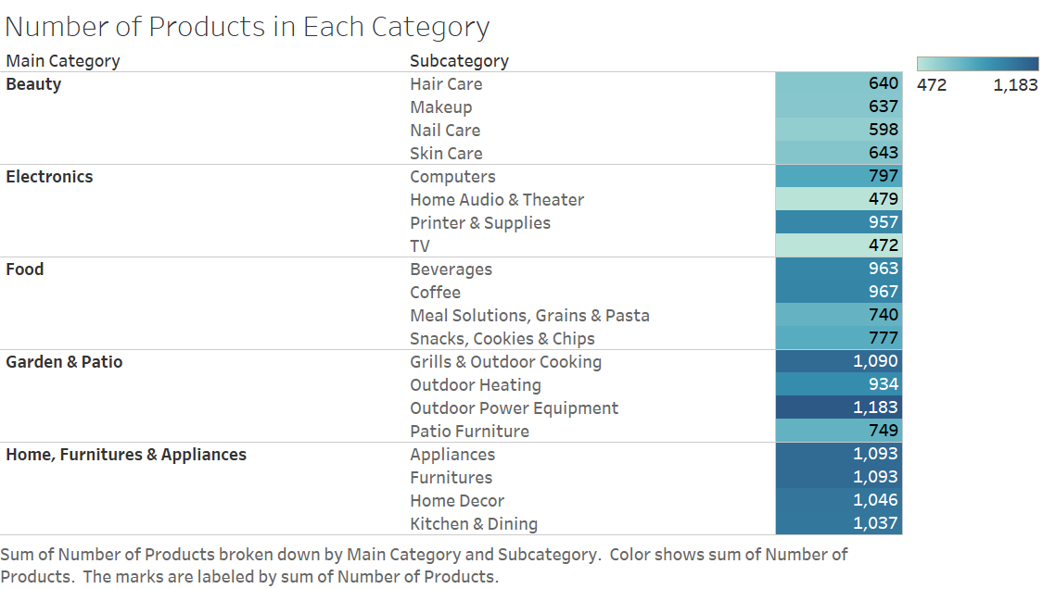
Products in Each Category

Slide 10
Hierarchical Structure of Data
Product
Beauty
Electronics
Home, Furniture & Appliances
Food
Garden & Patio
Furniture
Appliances
Home Decor
Kitchen & Dining
• Desks
• Chairs
• TV Stands
• Sofa
• Mattresses
• Bed Frames
• Bookcases
• Vacuums
• Microwaves
• Fridge
• Dishwashers
• Washer & Dryers
• Small Kitchen Appliances
• Ovens & Ranges
• Wall Art
• Candles
• Rugs
• Throw Pillows
• Curtains
• Lightings
• Mirrors
• Dinnerware
• Cookware
• Food Storage
• Tools & Gadgets
• Barware
• Cutlery
• Flatware

Slide 11
Agenda
Business intent
Exploratory Data Analysis
Approach & Methodology
Operational Execution & Change Management
Conclusion
Next Steps

Slide 12


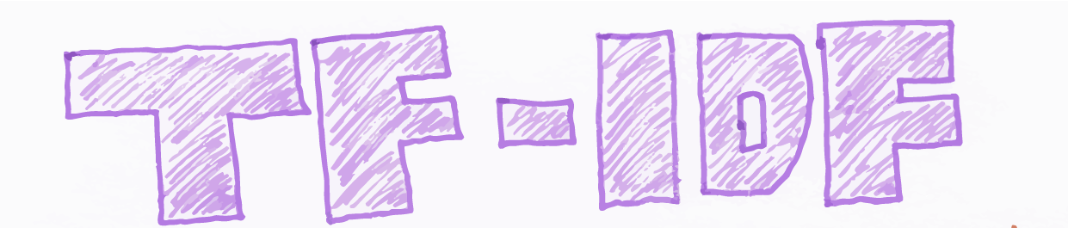
Feature Engineering
Three Word Embedding Technology:
— Universal Sentence Encoder

Slide 13
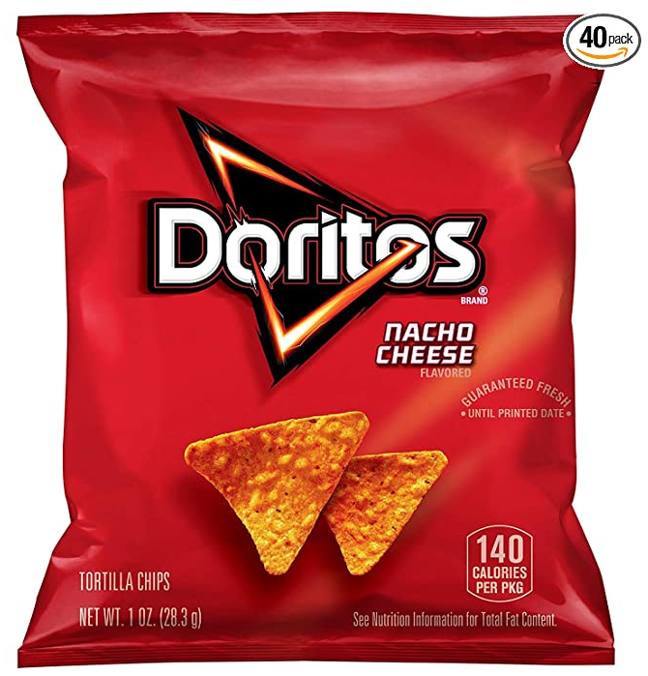
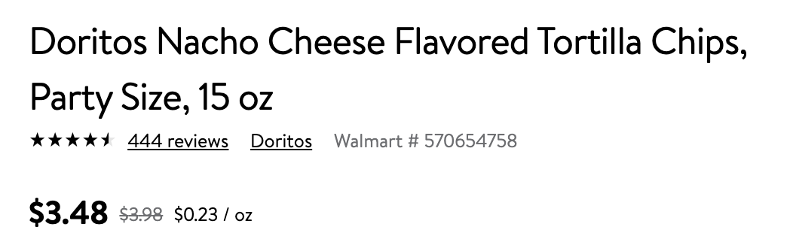
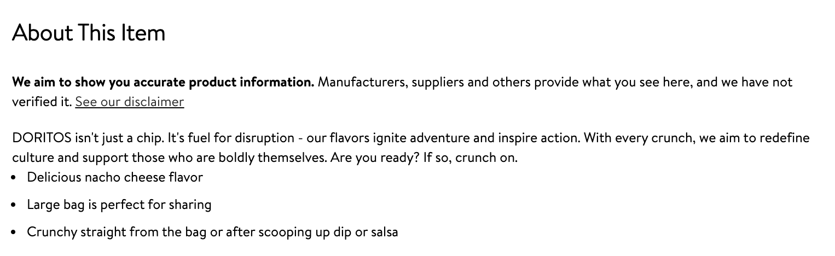
Feature Engineering
Data Input:
Product name
Product Description

Slide 14
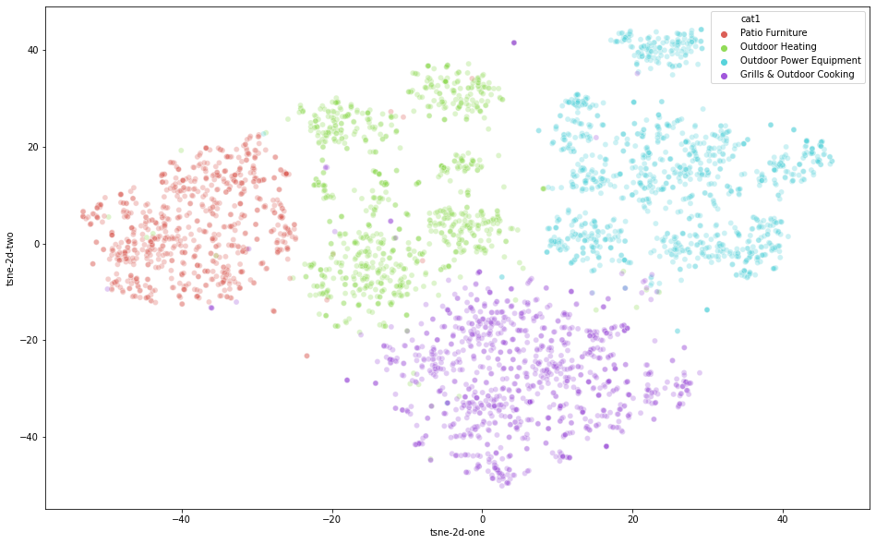
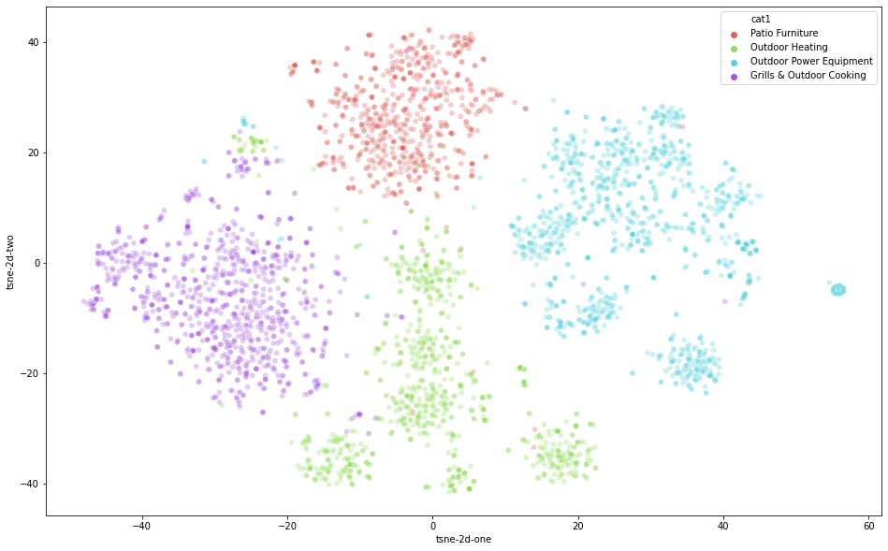
Feature Engineering
USE + Product Name USE + Product Description

Slide 15
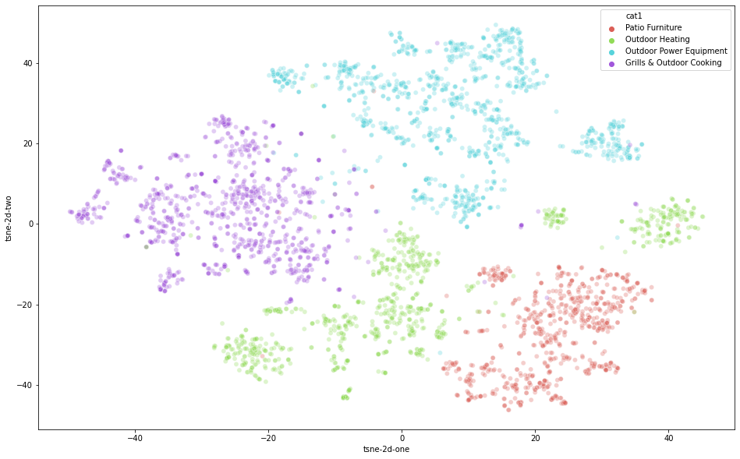
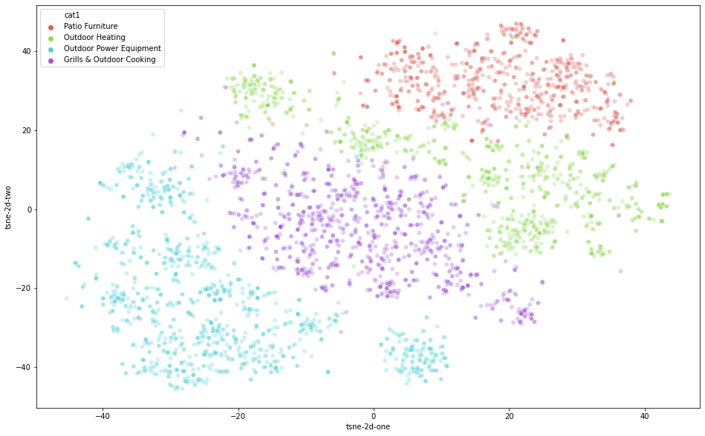
Feature Engineering
USE + Product Name
FastText + Product Name
Tf_idf + Product Name

Slide 16
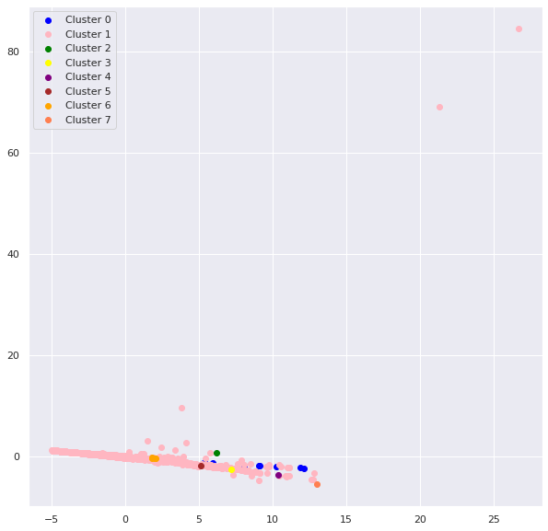
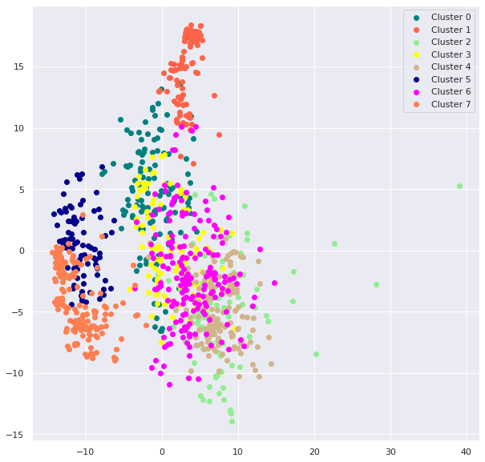
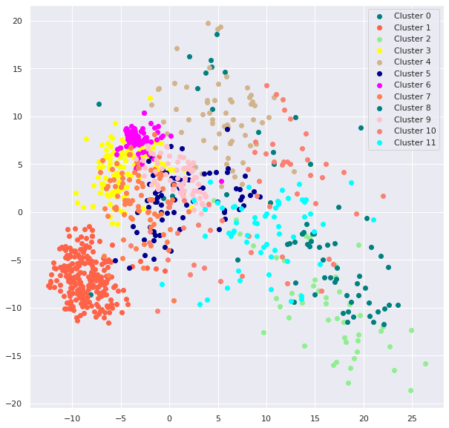
Clustering Analysis for Best Embedding Model
Gaussian Mixture Modelling (GMM)
tf-idf USE FastText
0.000039 0.2086 0.251260
Silhouette Score

Slide 17
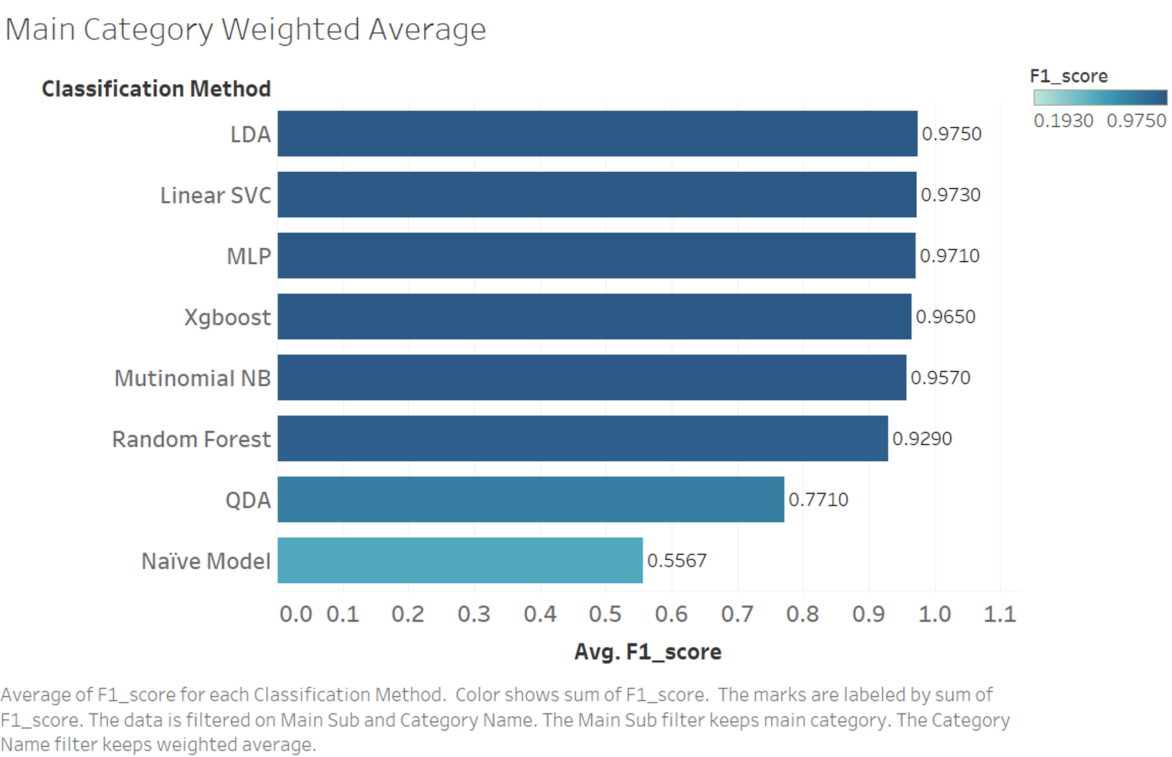
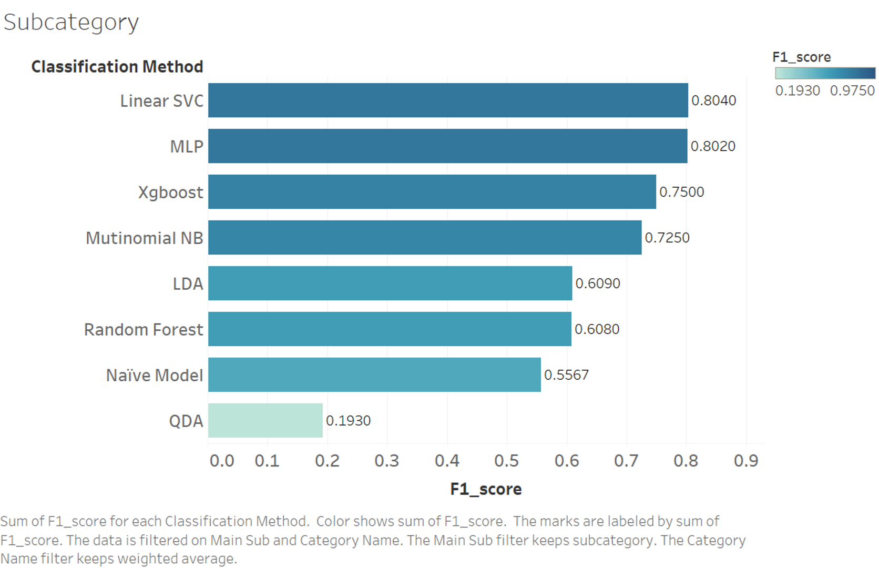
Predictive Modeling: Model Selection -- Classification
Notes:
Compare Classification Models by running them on the same USE result based on the same garden sample data

Slide 18
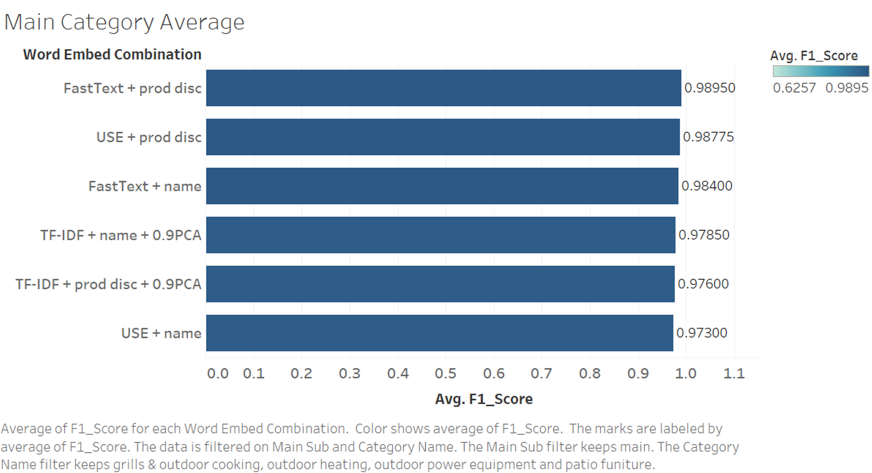
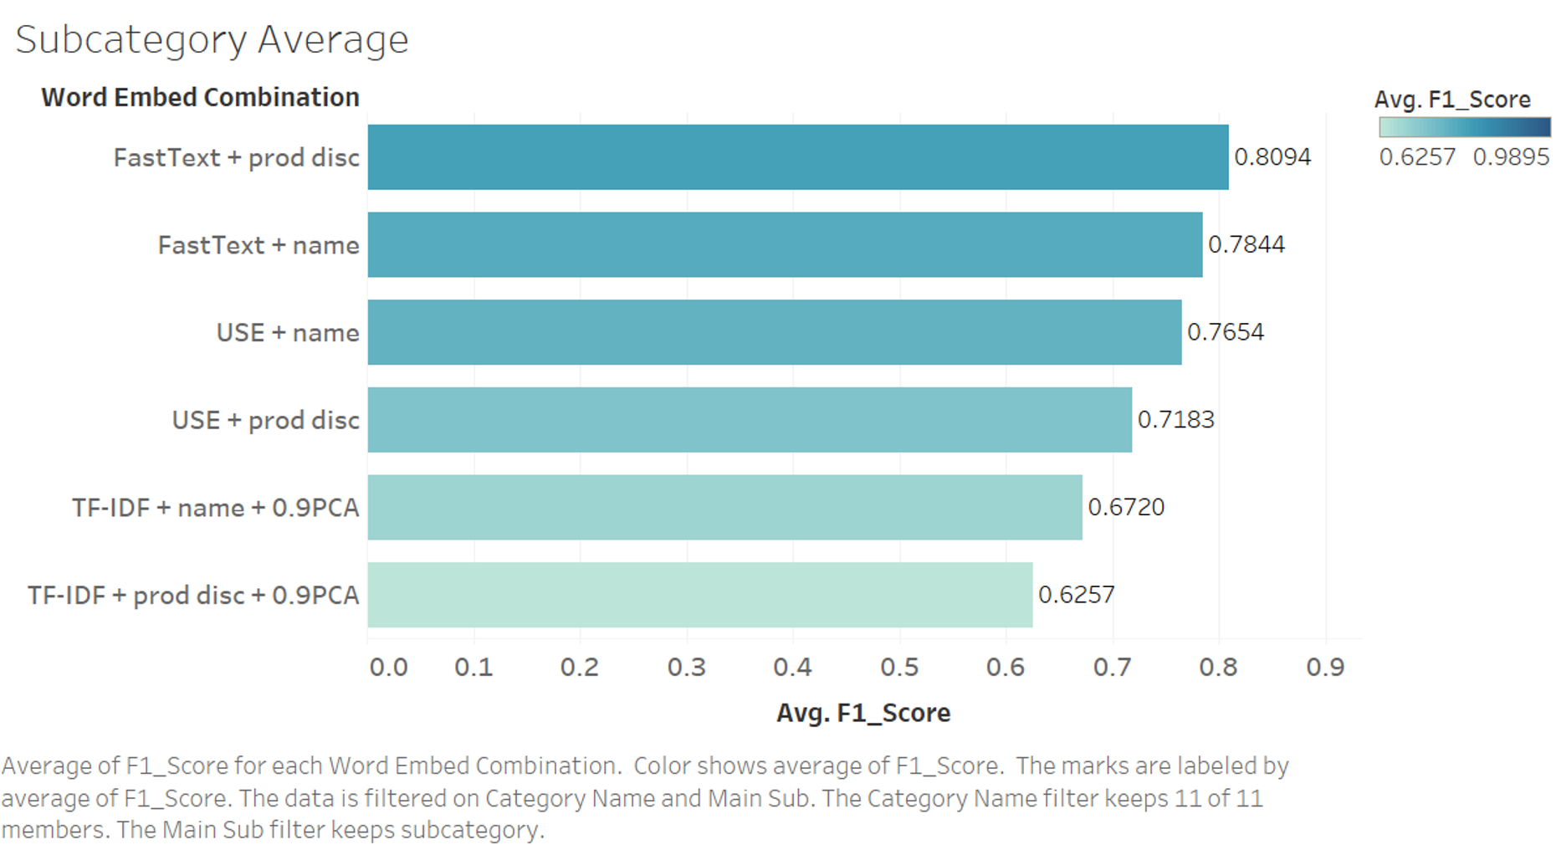
Predictive Modeling: Model Selection -- Word Embed

Slide 19
Predictive Modeling: Hierarchical Structure
Product
Model A
Beauty
Electronics
Home, Furniture & Appliances
Food
Garden & Patio
Model H1
Model S
Furniture
Appliances
Home Decor
Kitchen & Dining
• Desks
• Chairs
• TV Stands
• Sofa
• Mattresses
• Bed Frames
• Bookcases
Model H2A
• Vacuums
• Microwaves
• Fridge
• Dishwashers
• Washer & Dryers
• Small Kitchen Appliances
• Ovens & Ranges
Model H2B
• Wall Art
• Candles
• Rugs
• Throw Pillows
• Curtains
• Lightings
• Mirrors
Model H2C
• Dinnerware
• Cookware
• Food Storage
• Tools & Gadgets
• Barware
• Cutlery
• Flatware
Model H2D

Slide 20
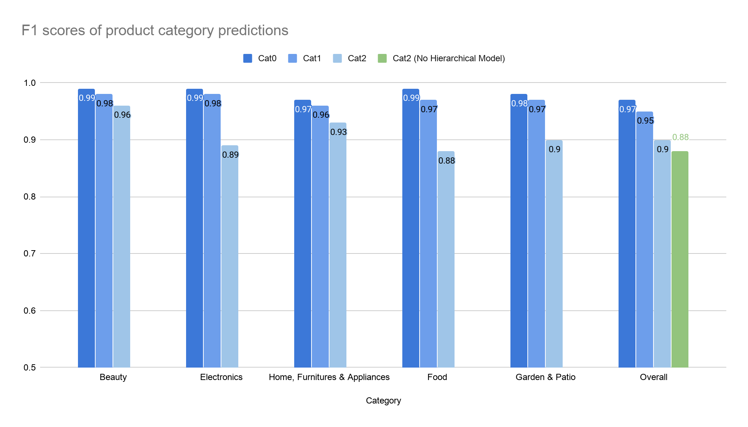
Predictive Modeling: Results
Accuracy: 0.898
F1 Score: 0.897

Slide 21
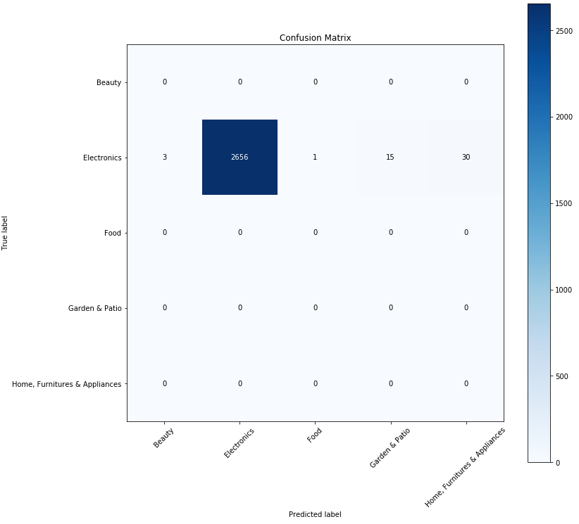
Predictive Modeling: Results - Electronics (Category 0)
All products predicted as “Electronics” category
Accuracy: 0.95
F1 Score: 0.99

Slide 22
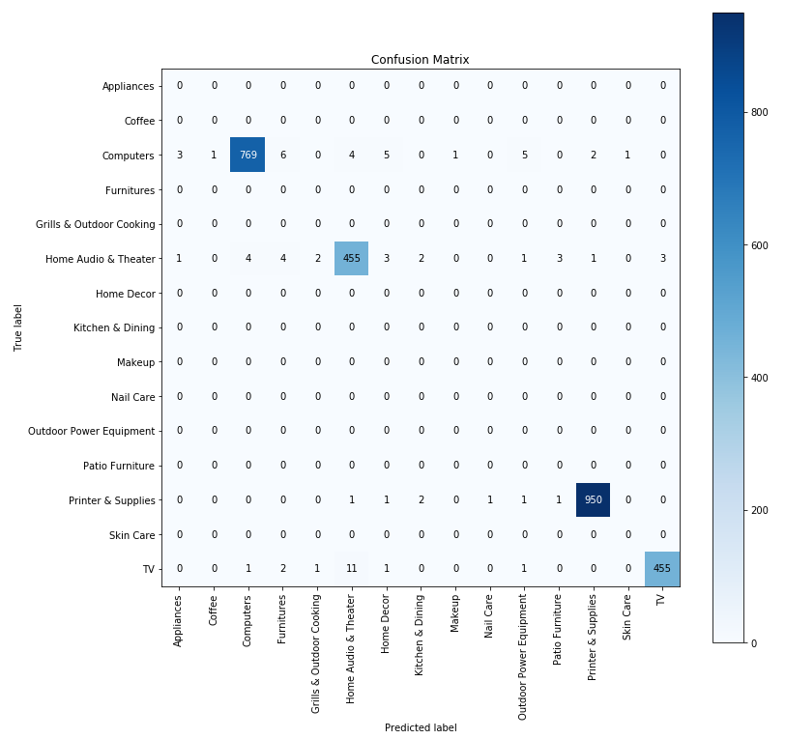
Predictive Modeling: Results - Electronics(Category 1)
All products predicted as
“Computers”,
“Home Audio & Theater”,
“Printers & Supplies, or
“TV”
Accuracy: 0.91
F1 Score: 0.98

Slide 23
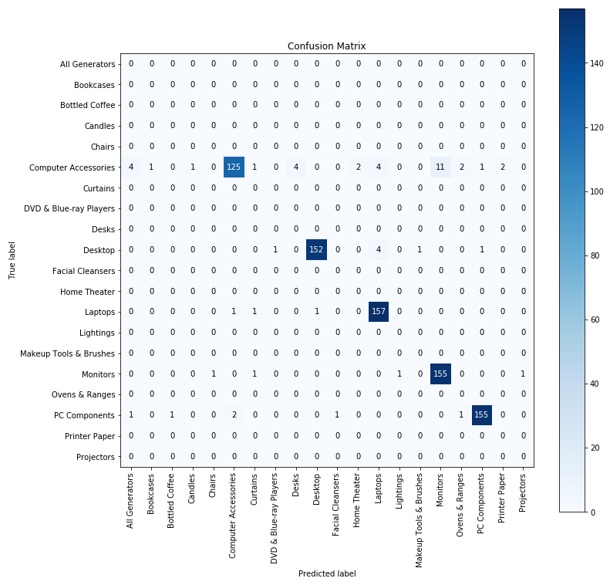
Predictive Modeling: Results - Electronics(Category 2)
All products predicted under the “Computer” category
Accuracy: 0.91
F1 Score: 0.95

Slide 24
Agenda
Business intent
Exploratory Data Analysis
Approach & Methodology
Operational Execution & Change Management
Conclusion
Next Steps

Slide 25
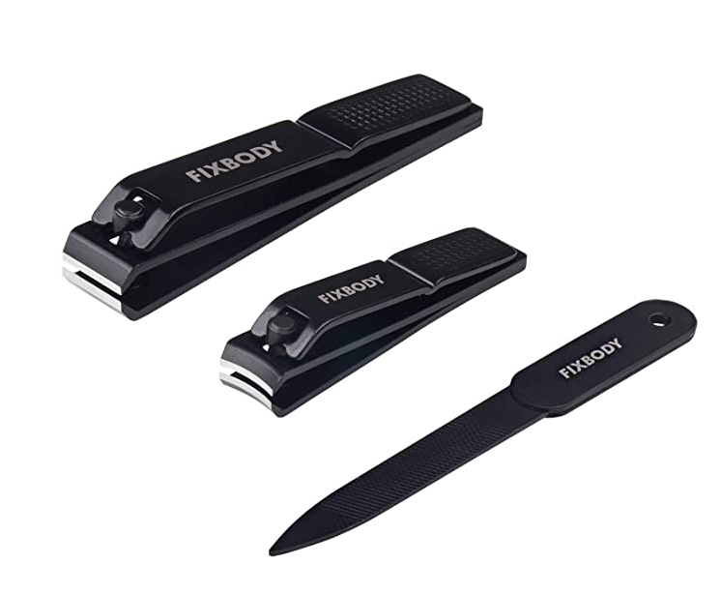
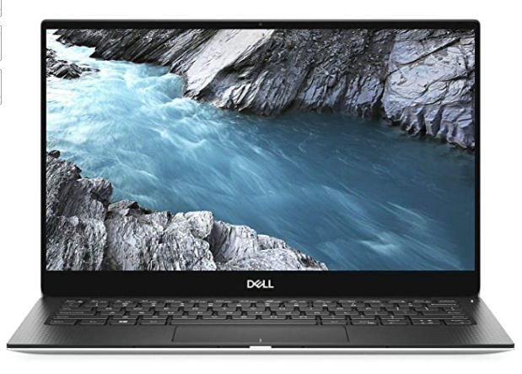
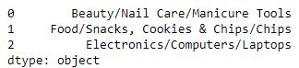
Product Path Generator
Product Names
USE_Encoder
Model_Maker
Product_Path_Generator
Product Category Paths
FIXBODY Nail Clipper Set – Black Stainless Steel Fingernails & Toenails Clippers & Nail File Sharp Nail Cutter with Leather Case, Set of 3 (Straight & Curved)
Doritos Nacho Cheese Flavored Tortilla Chips, 1 oz (Pack of 40)
Dell XPS 13 9380 13.3" Notebook - 1920 X 1080 - Core I5-8265U - 8GB RAM - 256GB SSD - Platinum Silver, Carbon Black

Slide 26
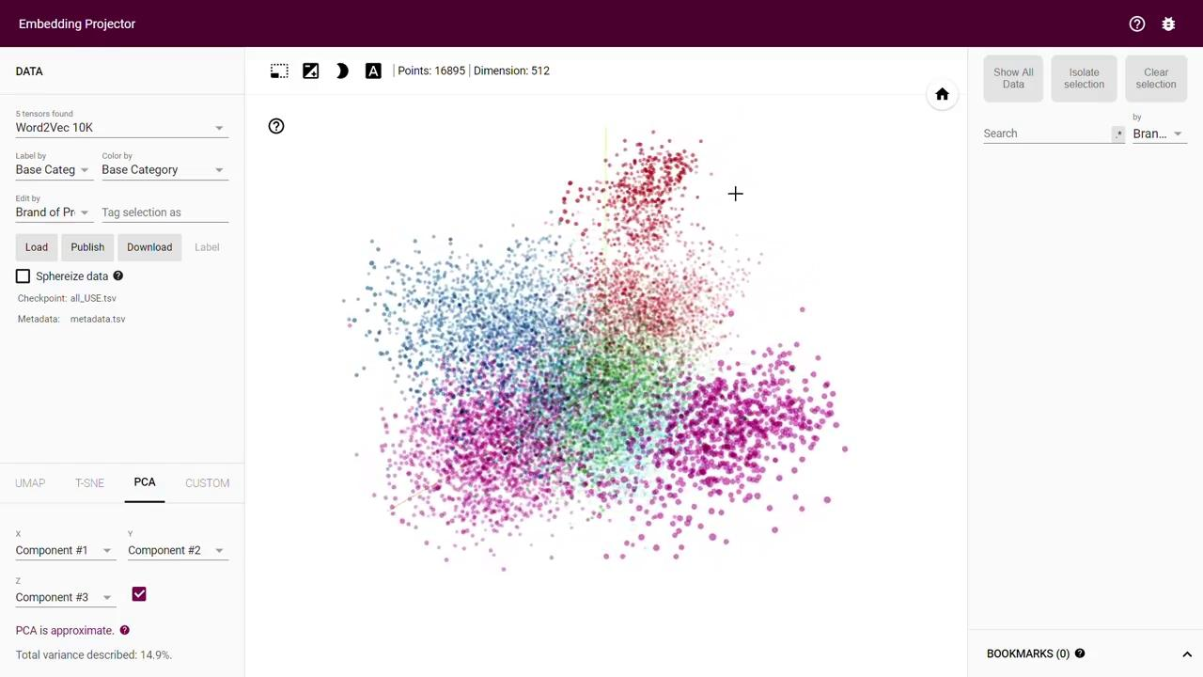
Similar(Semantically) Product Finder
TensorFlow Embedding Projector
(Word Embedding Method: Universal Sentence Encoder , Dimension Reduction: PCA)

Slide 27

Similar(Semantically) Product Finder
Searching, Navigating and Analysing Similar products

Slide 28
Agenda
Business intent
Exploratory Data Analysis
Approach & Methodology
Operational Execution & Change Management
Conclusion
Next Steps

Slide 29
Let’s recap
Scraped Data and Analysis
Best Word embedding Model
Best Classification Model
16,895 Products from 5 major categories
Universal Sentence Encoder
( On the basis of performance and computational feasibility)
Linear SVM
1
2
3
Similar Product Finder
Product Path Generator

Slide 30
Agenda
Business intent
Exploratory Data Analysis
Approach & Methodology
Operational Execution & Change Management
Conclusion
Next Steps

Slide 31
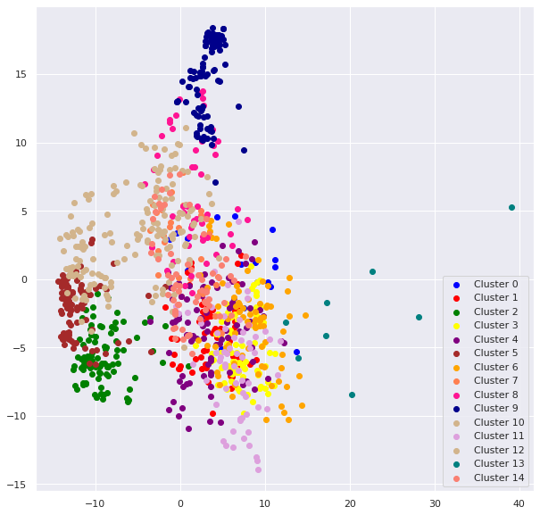
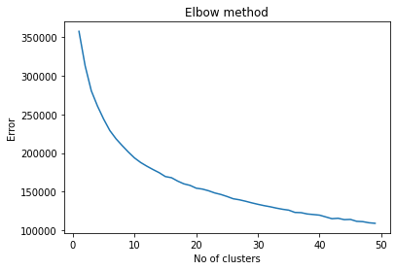
Clustering
Separability in data after the deepest level of categorization validates possibility of further classification
k-means
GMM
k-means
Topic Modeling Results are not well defined due to multiple overlaps in features
k = 15
Silhouette Score = 0.1934

Slide 32
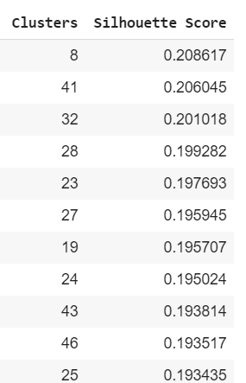
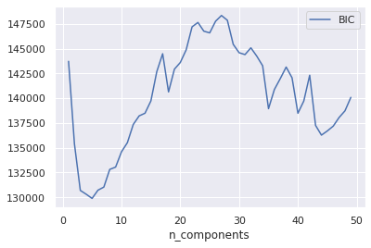
Gaussian Mixture Modelling (GMM)
Hyper Parameter Tuning for ideal number of clusters
Silhouette Score -> k = 8
BIC value -> k = 6,7 or 8
Therefore k = 8

Slide 33
Topic Modeling on the Clusters using LDA (Latent Dirichlet allocation)
Cluster 0 | LCD Screen , Tower Desktops
Cluster 1 | Dual Laptops, VGA Specs
Cluster 2 | Apple, iMac, Silver, Dents, Old
Cluster 3 | Intel, Professional, LCD, Pavillion
Cluster 4 | Gaming, RTX, Black, Omen
Cluster 5 | Monitor, Refurbished, Core
Cluster 6 | Pavilion, Dual, Refurbished
Cluster 7 | Refurbished, Windows Pro

Slide 34
Thank you

Slide 35
Appendix

Slide 36
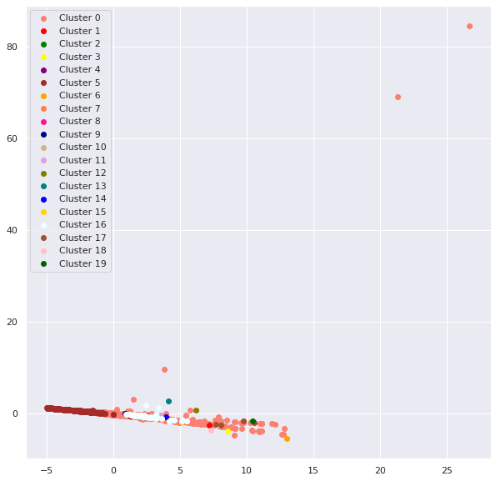
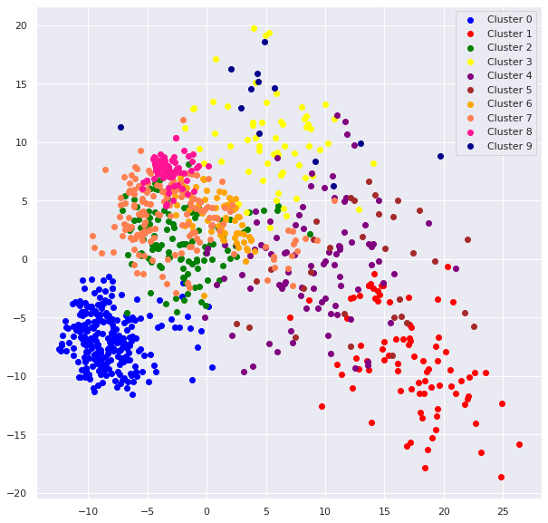
Clustering Analysis for Best Embedding Model
k-means
tf-idf USE FastText
0.00751 0.2934 0.2644
Silhouette Score

Slide 37
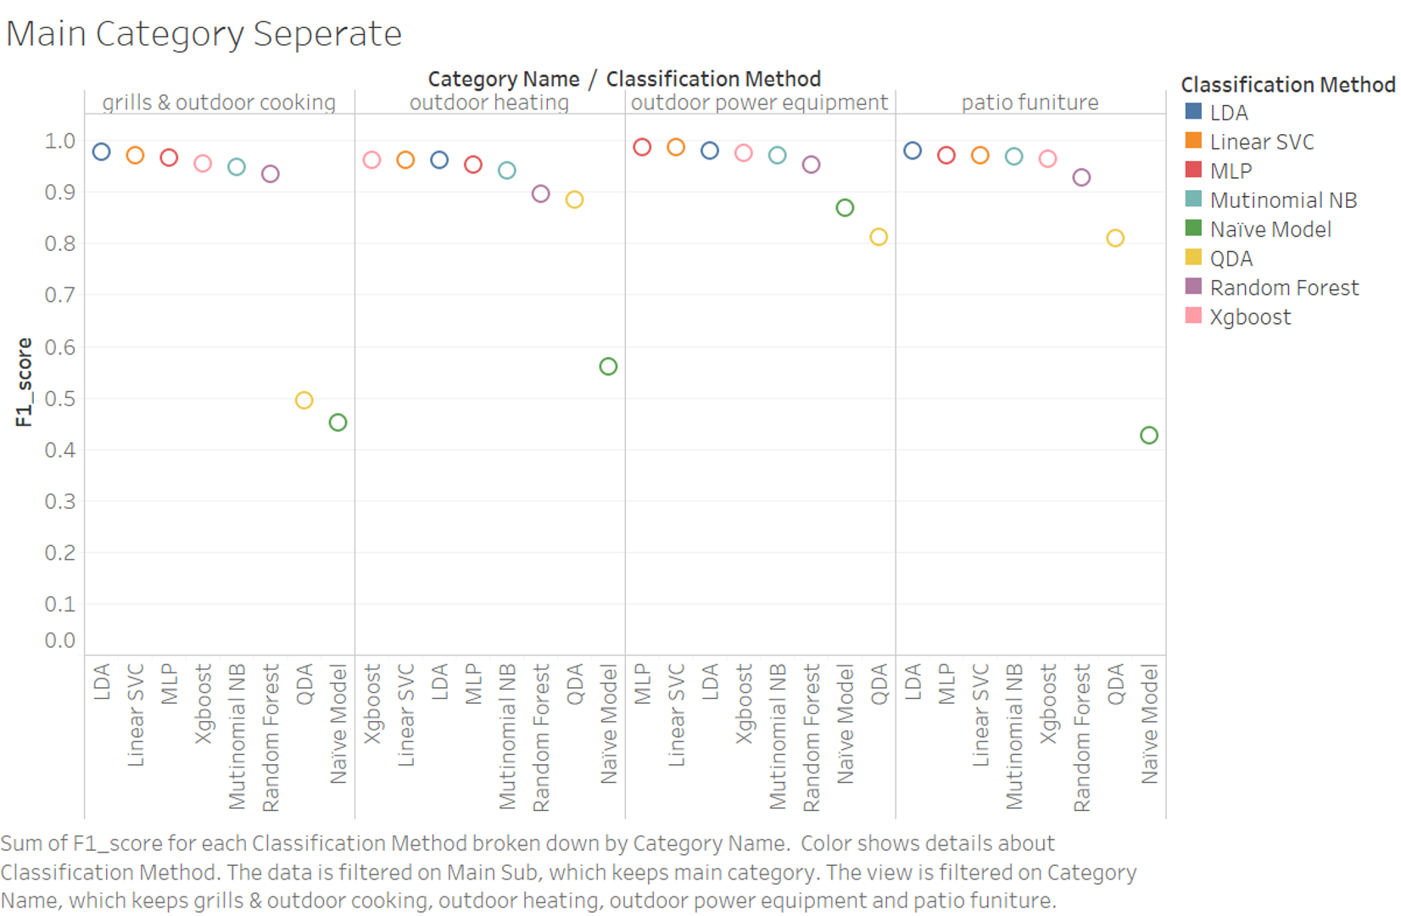
Predictive Modeling: Model Selection - Classification
Compare Classification Models by running them on the same USE result based on the same garden sample data
Notes:
Do we need a slide to list all the classification models? same with the word embedding combination

Slide 38
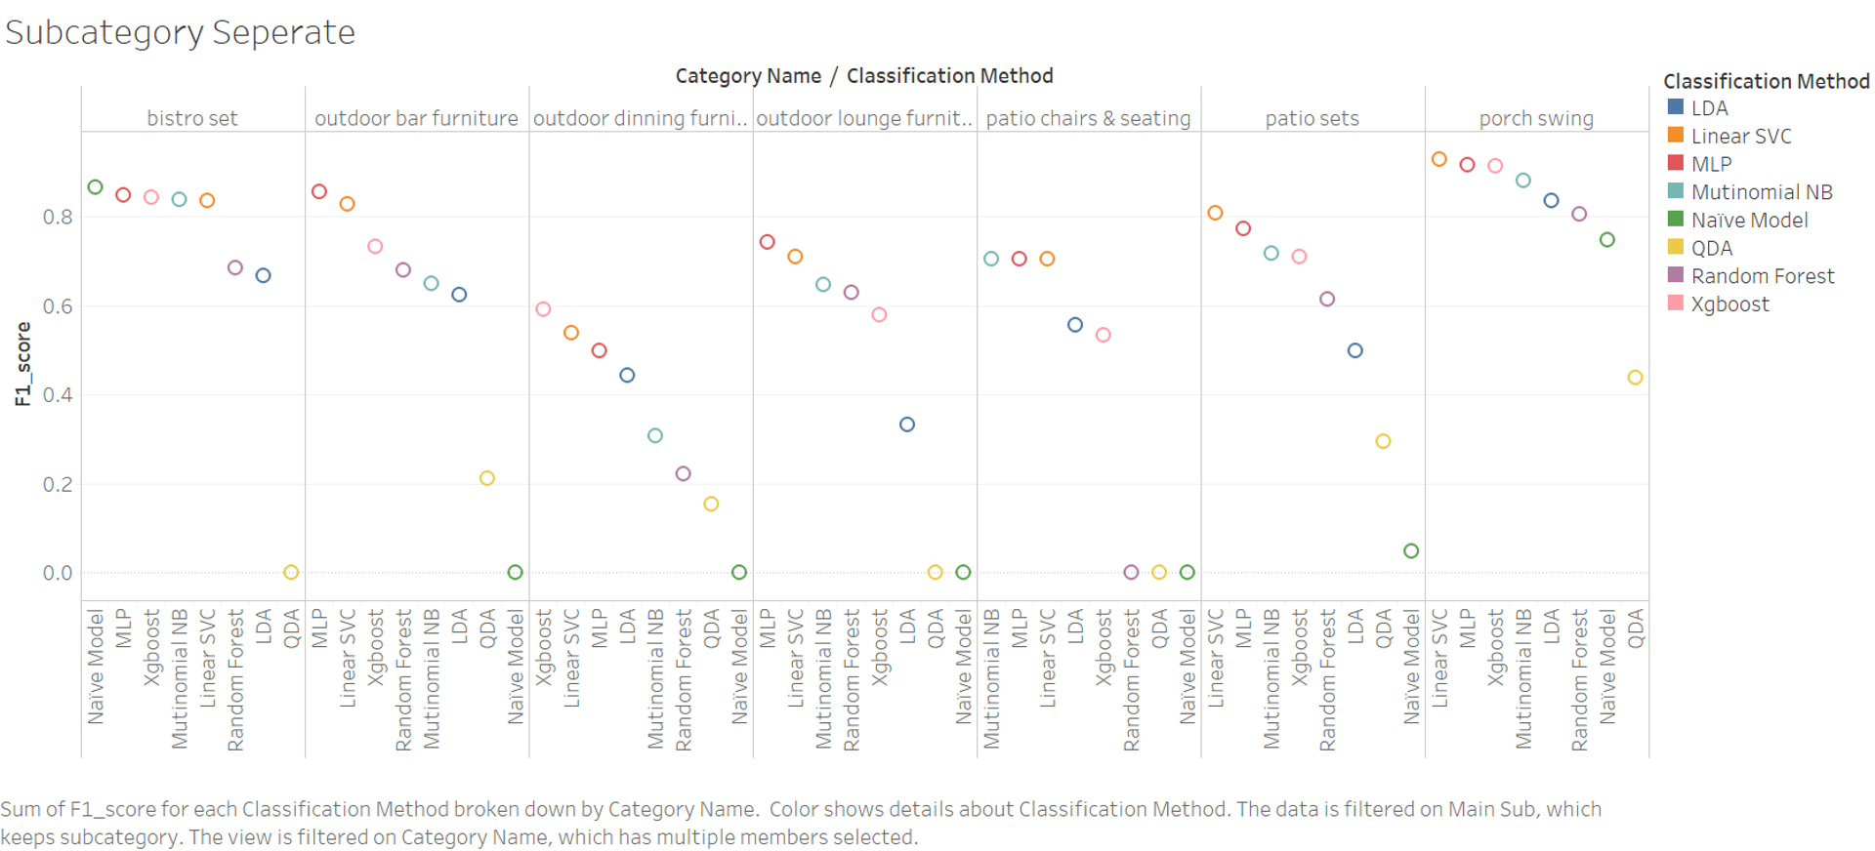
Predictive Modeling: Model Selection - Classification

Slide 39
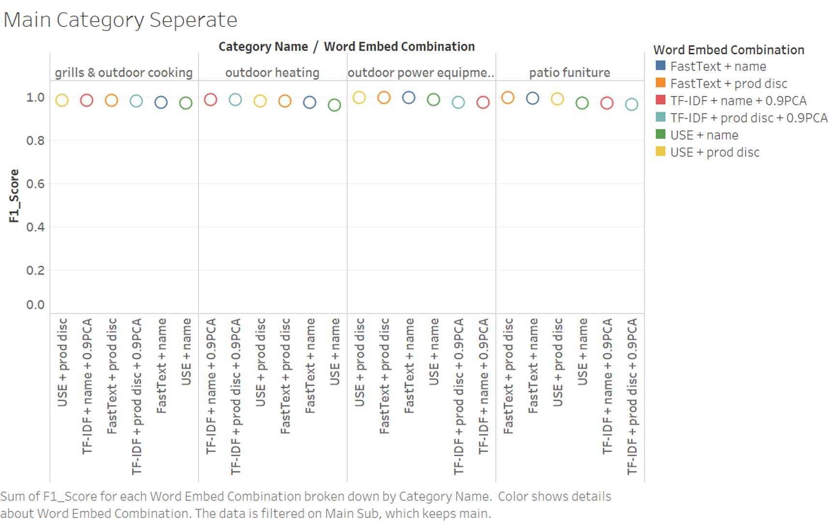
Predictive Modeling: Model Selection -- Word Embed
Compare different Word Embedding tech by using their results on the same LinearSVC classification model based on the same garden sample data

Slide 40
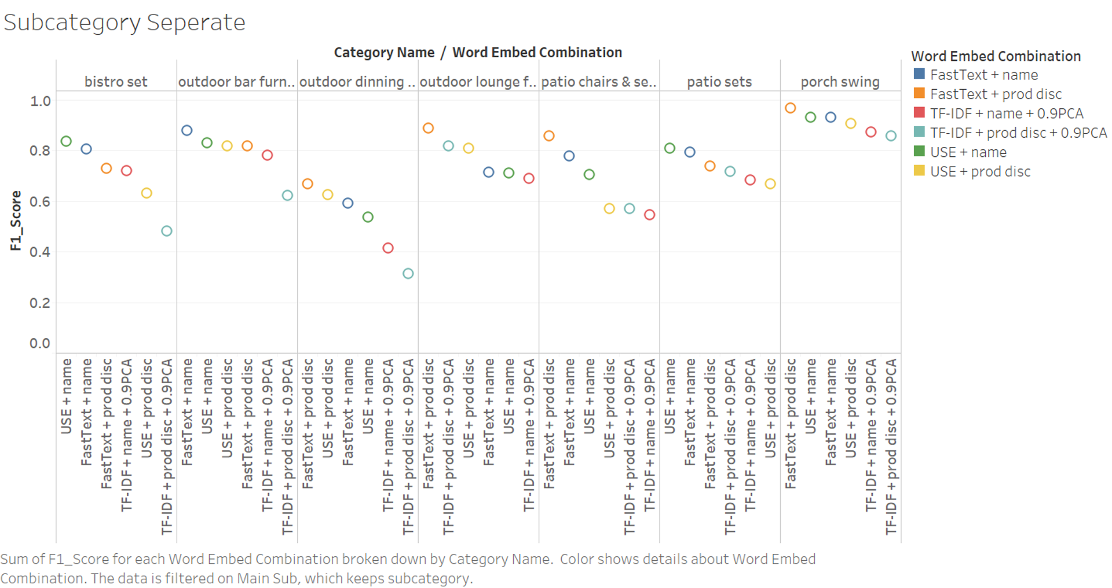
Predictive Modeling: Model Selection -- Word Embed

Slide 41
k-means Clustering
k = 15
Silhouette Score = 0.1934
Topic Modeling Results are not well defined due to multiple overlaps in features

